Slide 1


Dispelling Common Myths about Online Backup
How We Can Help You Protect Your Microsoft 365® Data
2024 Version

Slide 2
Who Safeguards Your Data?
Your business is constantly producing data you need for operations and growth. So who is responsible for protecting and backing it up?
Your Microsoft 365® Business Data
Microsoft
You
Solidarity IT
Most people assume Microsoft® backs up all of its SaaS data, but there are automated limits on data retention.
Without Backup for Microsoft 365, deleted files and accounts could be unrecoverable.
We can back up your data with Backup for Microsoft 365—but only if you choose this service.

Slide 3
Myth #1:
Microsoft Backs Up All My Data
Your business uses Microsoft 365 apps to do business, so Microsoft protects all your data, right?
Unfortunately, no.
Microsoft focuses on delivering critical services your business uses.
Microsoft does not protect you against permanent deletion of files or accounts, whether accidental or intentional.

Slide 4
Myth #2:
Your Managed Services Provider Can Recover Anything
We can help you recover from backup challenges like these, right?
You need to recover permanently deleted files at any time.
You need to recover soft-deleted files after 90 days.
You need to recover departed employees’ accounts after 30 days.
You need to restore maliciously deleted email accounts or files.
Ransomware attack freezes your access to your data.
A hacker is controlling your Outlook® accounts and sending emails in your employees’ names.
We can’t help you recover these files and accounts unless you have Backup for Microsoft 365.

Slide 5

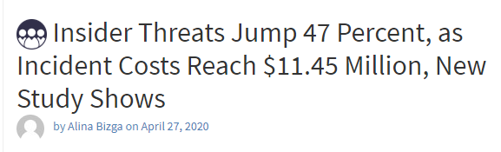
Myth #3:
My Employees Always Do the Right Thing
I know my employees. They wouldn’t try to hurt my business, would they?
While most data loss is accidental, employees can delete data to sabotage companies—especially if they have an axe to grind, such as having been demoted or terminated.
In April 2020, the U.S. Department of Justice arrested a terminated employee of a medical supply company based in Georgia.
He used his administrative access to log in using a fake user account, disable shipping, and delete thousands of company records, causing losses of greater than $5K. (£3.8K)
Source: “Insider Threats Jump 47 Percent, as Incident Costs Reach $11.45 Million, New Study Shows,” Security Boulevard. https://securityboulevard.com/2020/04/insider-threats-jump-47-percent-as-incident-costs-reach-11-45-million-new-study-shows/ (accessed August 2020).

Slide 6

How to Buy
Myth #4:
Microsoft 365 Backup Module | £3/User/Month
Documents Backup Module | £2/Computer/Month
Workstation Backup Module | £15/Computer/Month
Online Backup Is Too Expensive
Backup for Microsoft 365 is just another IT cost I have to cover, right?
Yes, but it only costs a few pounds per user per month
There’s no on-premises hardware to maintain
It will pay for itself if you have a security incident
Downtime Costs
A survey of SMBs found that unscheduled downtime cost them:
10% >50K/Hour
13% 40–50K
25% 20K–40K
26% 10K–20K
27% <10K
Source: “Unexpected downtime is crippling businesses, causing revenue losses,” Help Net Security. https://www.helpnetsecurity.com/2020/05/14/unexpected-downtime/ (accessed August 2020).

Slide 7
Myth #5:
Online Backup Puts My Files at Risk
Putting my files in the cloud means they can be hacked more easily, right?
Cloud data is more secure than laptop or server data.
Laptops and PCs
May have poor passwords
May not be patched
Can easily be lost or stolen
Servers
May have default passwords
May not be patched
May have unknown vulnerabilities
May fail and lose data if not backed up
Microsoft 365 provides:
Physical security
Logical security
App-level security
User/admin control
Backup for Microsoft 365:
Provides the same cloud data protections as Microsoft 365
Stores data in a different location

Slide 8
Myth #6:
Online Backup Is Hard to Use
My small business already has too many IT tools to use. Won’t this complicate day-to-day operations?
We will install and manage your Backup for Microsoft 365 for you. Gain the peace of mind of a fully managed solution.

Slide 9
Common Use Cases for Online Backup
Business Continuity
Use point-in-time recovery to restore files at any time, helping keep your business running in all conditions.
Workforce Productivity
Keep teams working with easy access to the data they need and fast recoverability of deleted files and accounts.
Protect Against Security Threats
Safeguard data against ransomware, viruses, malicious deletion or data change, and business email compromise.
Get Backup for Microsoft 365, the solution that will grow with your:
Workforce
Business
Data
Regulatory needs
Customer Data Protection
Recover data that’s the lifeblood of your business—contracts, emails, project documents, and contact information.
Company Information Policy Requirements
Make sure your backup policies match your backup program.
Regulatory and Compliance
Keep data to meet audit and regulatory requirements.
Legal Defense
Maintain the data you need to defend your business against lawsuits.

Slide 10
Recommended Approach
 | Microsoft’s Responsibility | Your Responsibility (Together with Solidarity IT)
Primary Responsibility | Microsoft Global Infrastructure Uptime of the Microsoft 365 Cloud Service | Your Microsoft 365 Data Access and control of your data residing in Microsoft 365
Supporting Technology | Microsoft 365 Data Replication DC to DC georedundancy | Microsoft 365 Backup Copy of your data stored in a different location
 | Recycle Bin Limited short-term data loss recovery | Full Data Retention ST and LT retention filling any/all policy gaps granular and point-in-time recovery options
Security | Infrastructure-Level Physical security Logical security App-level security User/admin controls | Data-Level Internal Accidental deletion Malicious insiders Employee retaliation Evidence tampering External Ransomware, malware hackers, rogue apps
Regulatory | Role as Data Processor Data privacy regulatory controls Information Commissioner’s Office | Role as Owner Answer to corporate and industry regulations Demands from internal legal and compliance offices
If you add Backup for Microsoft 365 you’ll get an end-to-end solution that helps you defend against security threats, file and account deletion, and more.
With Backup for Microsoft 365, you empower us to help you protect and recover your Microsoft 365 data.

Slide 11
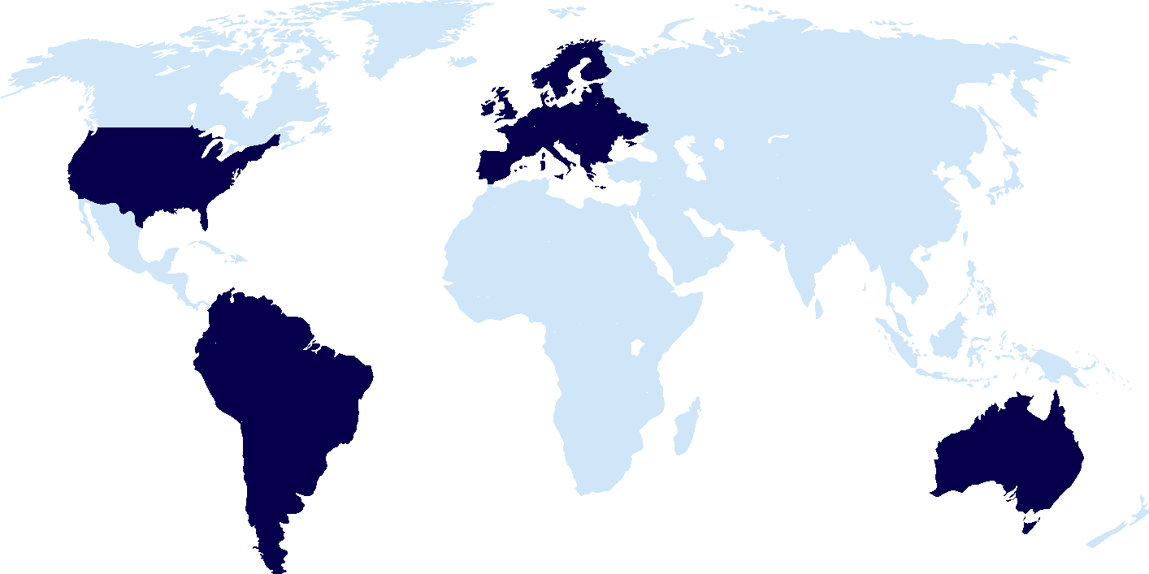
We Back Up Your Data in Your Region
Back up your data in your choice of more than 30 data centers, located across 17 countries and more than four continents. We have multiple locations in the US, Europe, Latin America, and Australia.

Slide 12

About Us
Solidarity IT was established in November 2016 by me, Andy Cooper and my colleague Valerie Green, to offer support and advice to all those for whom the complexities of IT are a burden and a distraction from achieving their business's goals.
We chose the name Solidarity IT to encapsulate out vision of working together in tandem with others, our drive to support not just our own households, but other small and micro business owners on their own journeys.
Our services cover all aspects of IT support from help and advice in choosing computers and networks, setting up and managing computers for you, data management, remote support to keep your computers safe and up to date, repairing your systems should it have a fault and more.

Slide 13

01392 984873 | www.solidarityit.com
Andy Cooper, Technical Director

